Slide 1

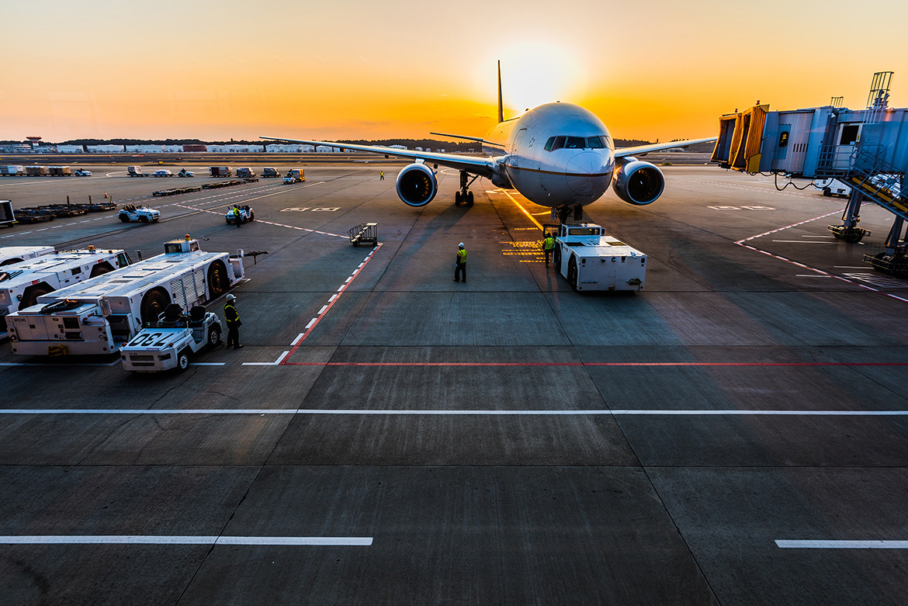
DATA AND BUSINESS ANALYTICS COURSE
Simulation Model for Mobile Cleaning Teams at Changi Airside to Aid Manpower Optimization
Team 13
MID TERM REPORT | OCTOBER 2020

Slide 2
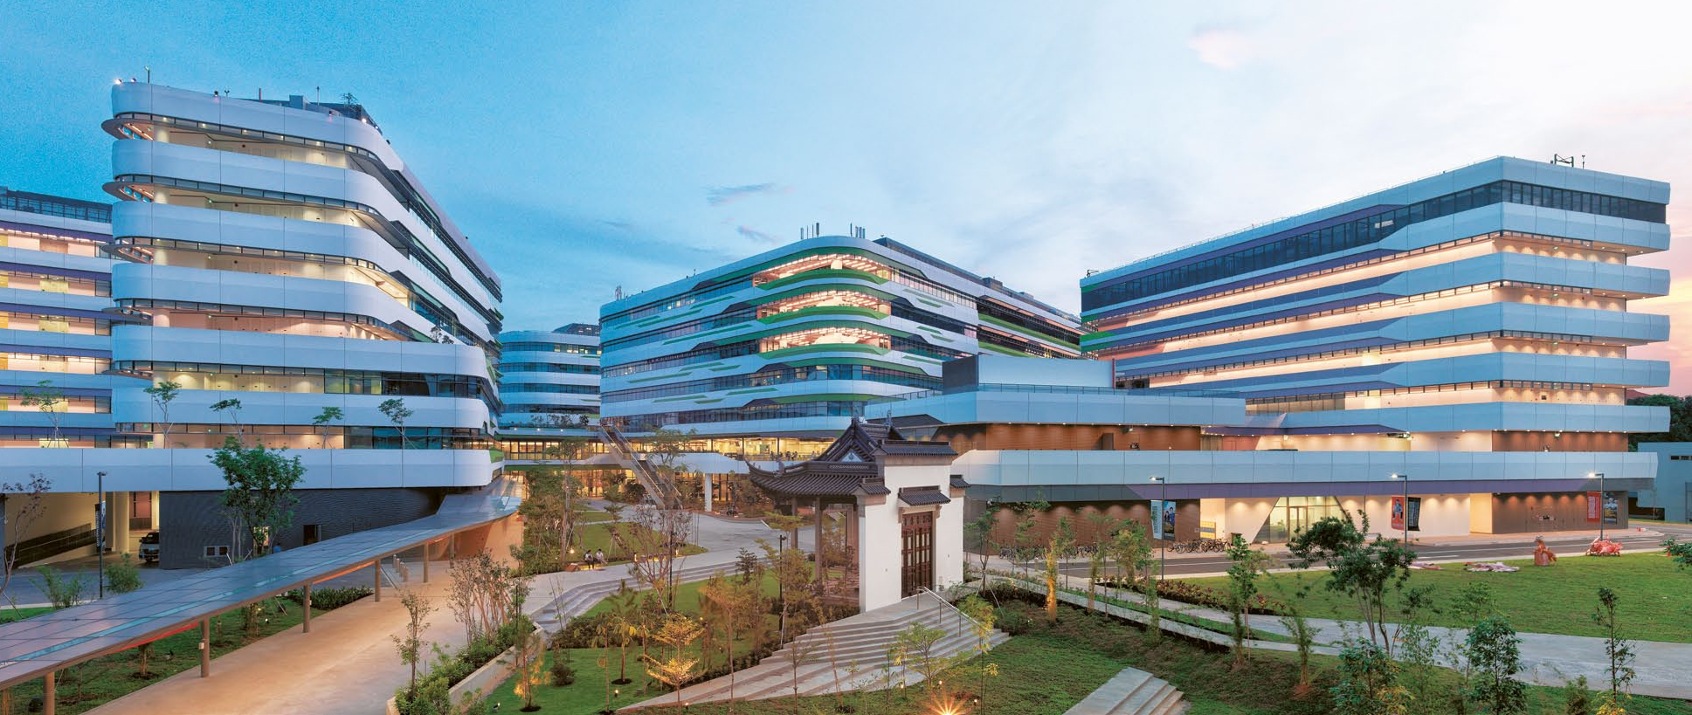


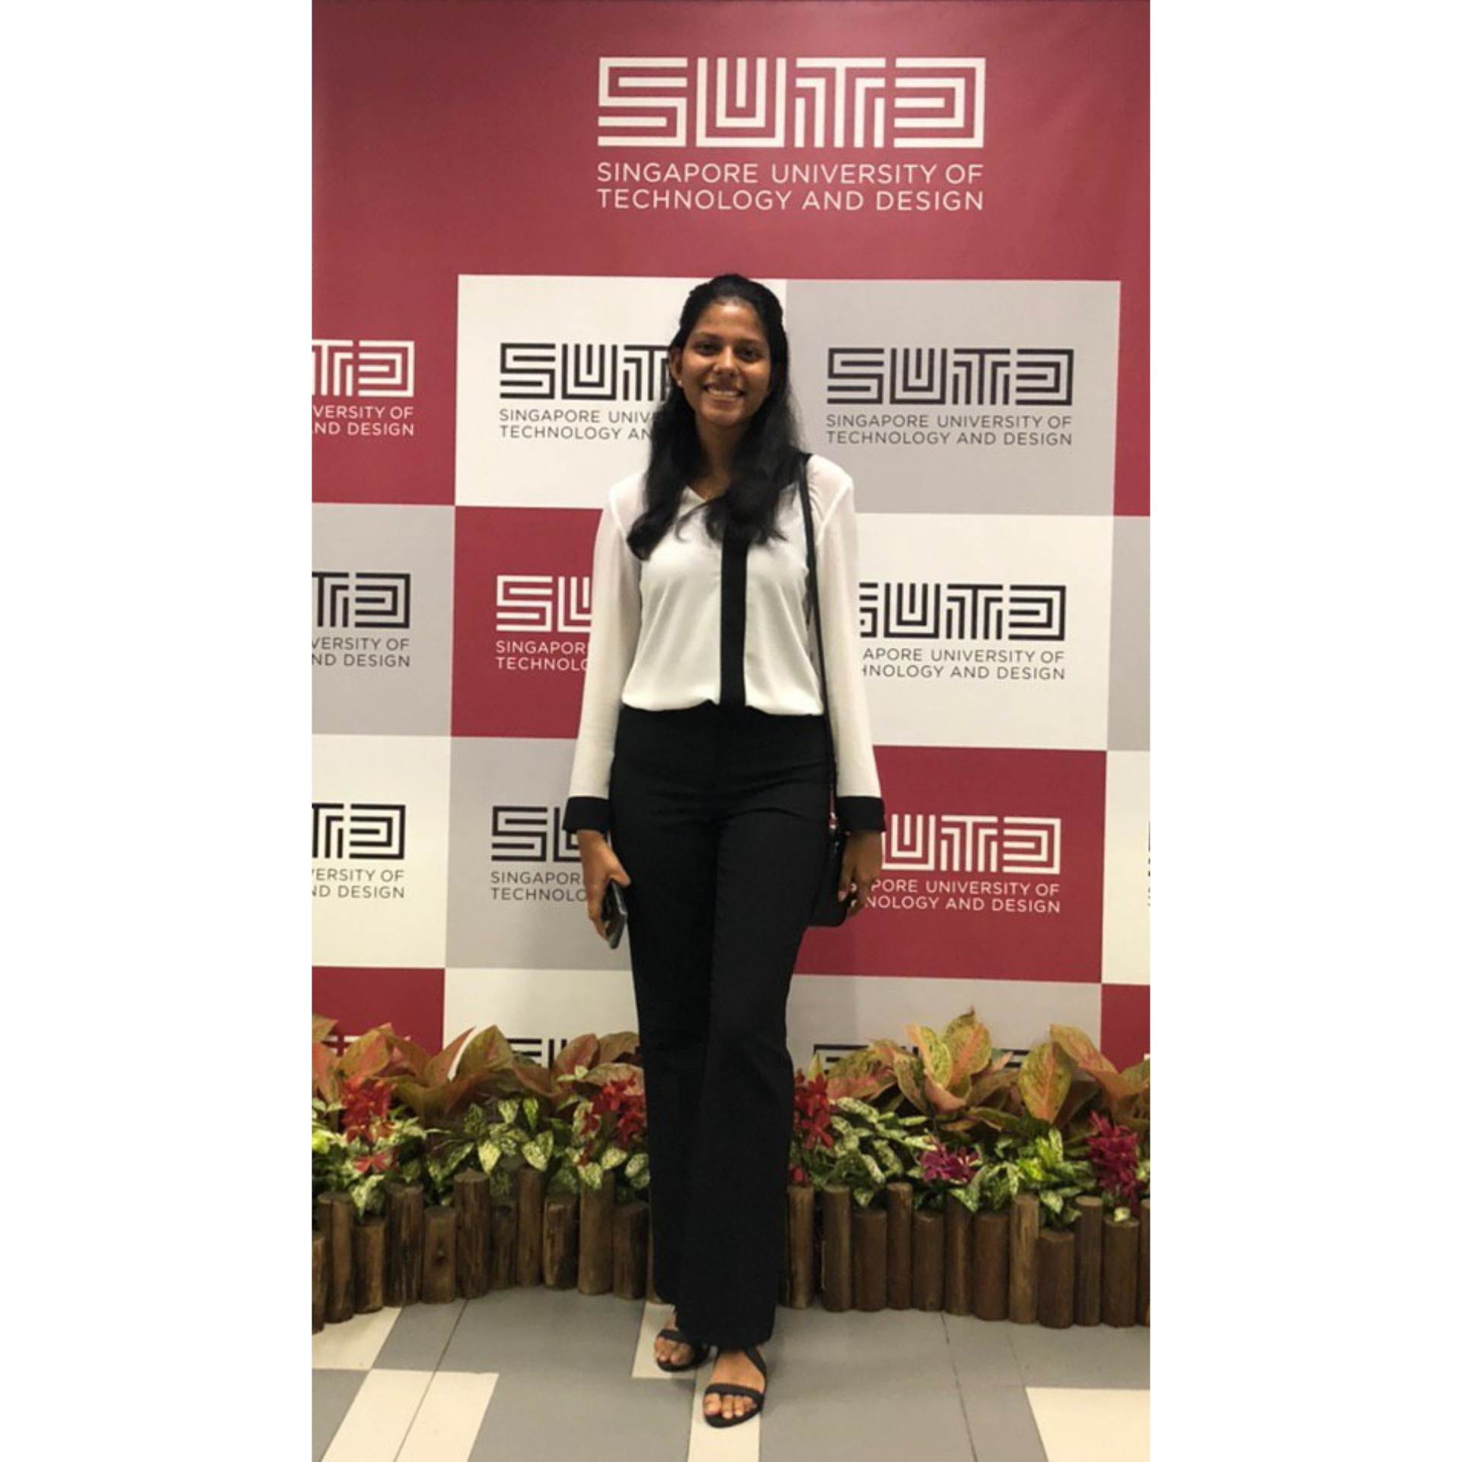



The Team
01
ENGINEERING MANAGEMENT & SYSTEM PLANNING
EMILY LIM
DAMIEN HEW
CHARINI JINADASA
RICHIE WONG
LEADER
LIAISON
REPORT COORDINATOR
MANAGER
LIU MENGLU
SENIOR ASSOCIATE
LIM TING YIN
ASSISTANT MANAGER
FRANCISCO BENITA
SUTD ADVISOR
HAZWAN HAFIZ
SAMUEL SIM
SCRIBE
SCRIBE

Slide 3
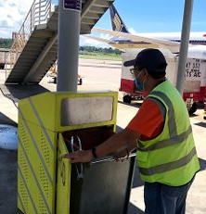
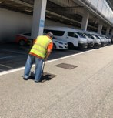
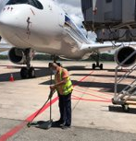
02
Problem Statement
A gradual ramp up of flights is expected as COVID restrictions are slowly being lifted.
There is a need to create a model to optimize the amount of manpower resources needed to :
1. Respond to and clear the FOD (Foreign object debris) bins or smart bins at the airside.
2. Perform sweeping and litter picking at the aircraft stands and airside roadways.
Phase 1 : Assess the current allocation of cleaning teams per shift to evaluate whether it is optimal.
Phase 2 : Optimize the number of teams required per shift by considering the new implementation of smart bins.
MID TERM REPORT | OCTOBER 2020

Slide 4
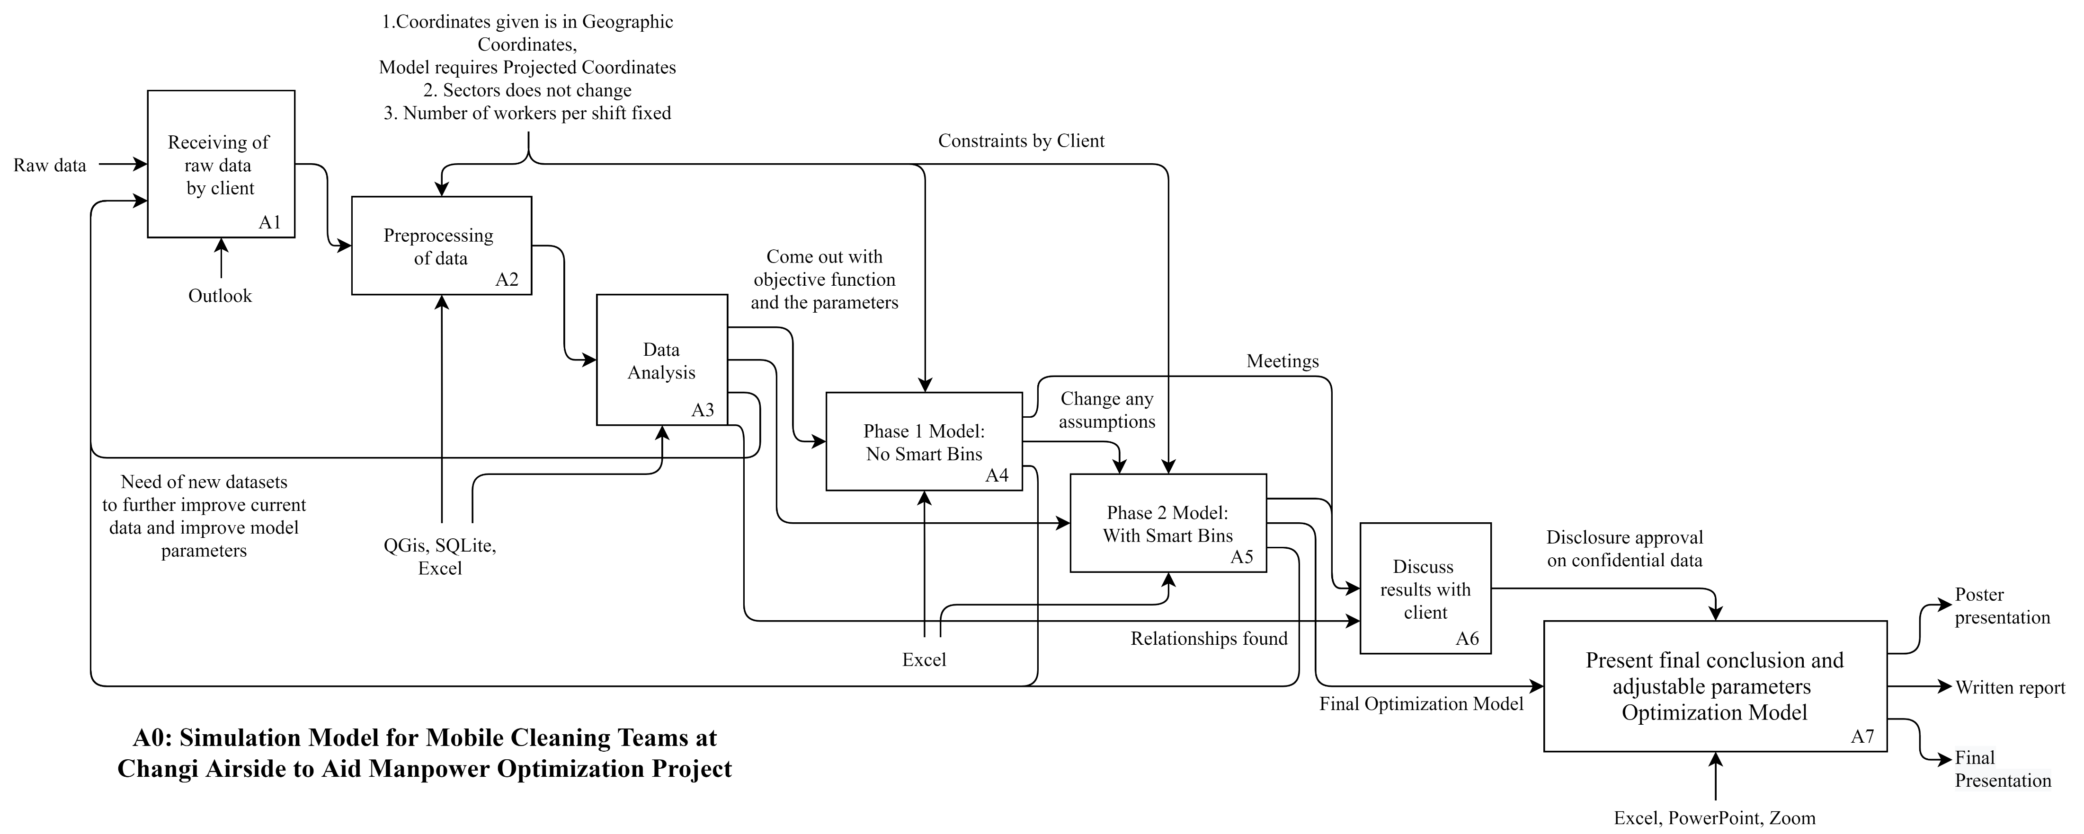
03
IDEF0
& Timeline
DATA ANALYSIS
14TH OCTOBER 2020
PHASE 1 MODEL
30TH OCTOBER 2020
PHASE 2 MODEL
11TH NOVEMBER 2020
MID TERM REPORT | OCTOBER 2020

Slide 5
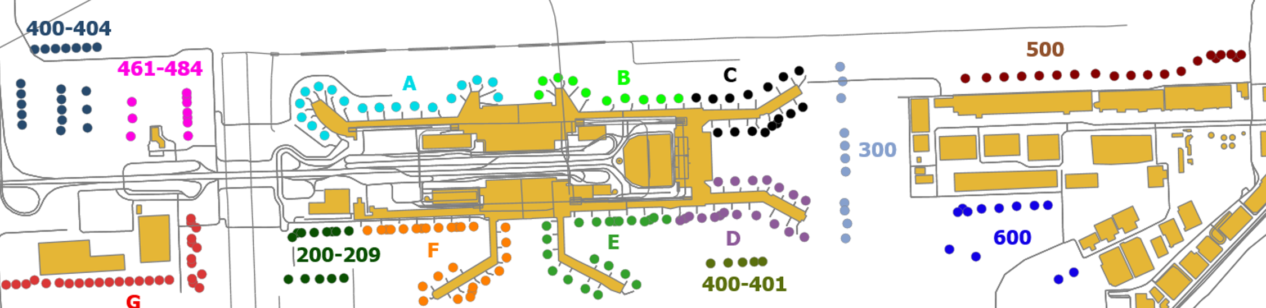
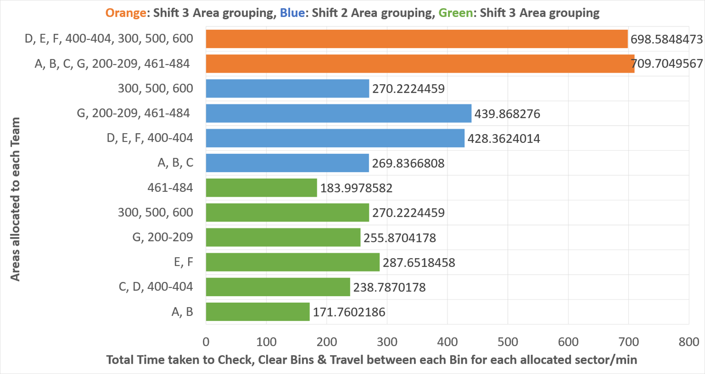
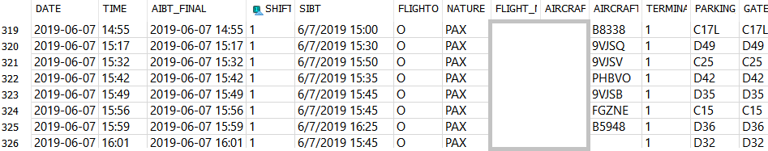
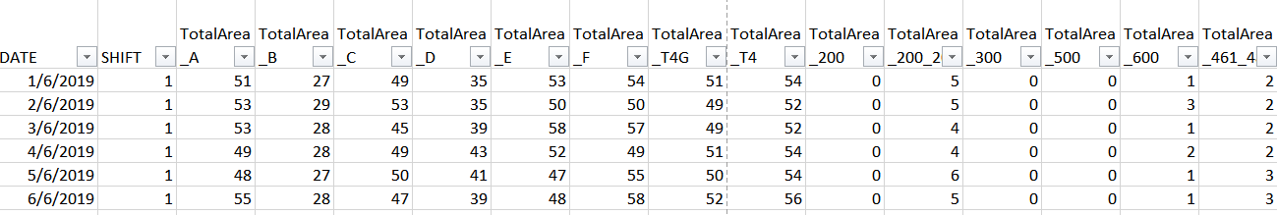
04
Data Visualization
1. Changi Aerodrome Map: Plotted in QGIS, the different sectors
3. Time taken to Check, Clear and Travel for each sector for each Shift:
Using Excel, each bar represents the areas allocated to 1 Team (1 pair of workers)
2. Flight Volume Data: Preprocessed using SQLite, order by shift before summed up
MID TERM REPORT | OCTOBER 2020

Slide 6

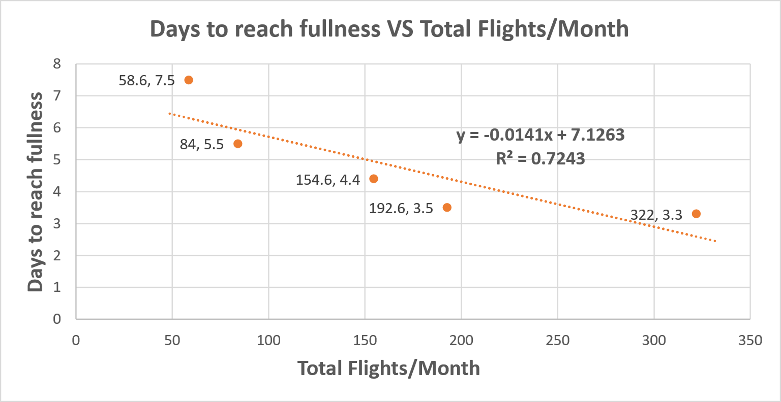


05
Proposed Optimization Model
Linear Model: Relationship between Flight Volume and Rate of bins filling up
Current Objective:
Reduce man-power hours for cleaning teams
Input Parameters:
Flight Volume
Number of gates in operation / Travel distance
Time to service bins
Proposed Model:
Flight volume is proportional to the rate of bins filling up. X number of flights will result in Y days for the bins to fill up. Can set (Y-1) days as the frequency to check bins that implies lesser bins to check.
Optimize excess time after servicing bins by having a team to work on other areas, results in less teams needed.
MID TERM REPORT | OCTOBER 2020

